Slide 1
Image-based HiC scaffolding
Yuhuai Luo
Member: Yuhuai Luo, Chen Wu & Sam Birch
Others: Usman R, Cecilia Deng and Harris Lin

Slide 2

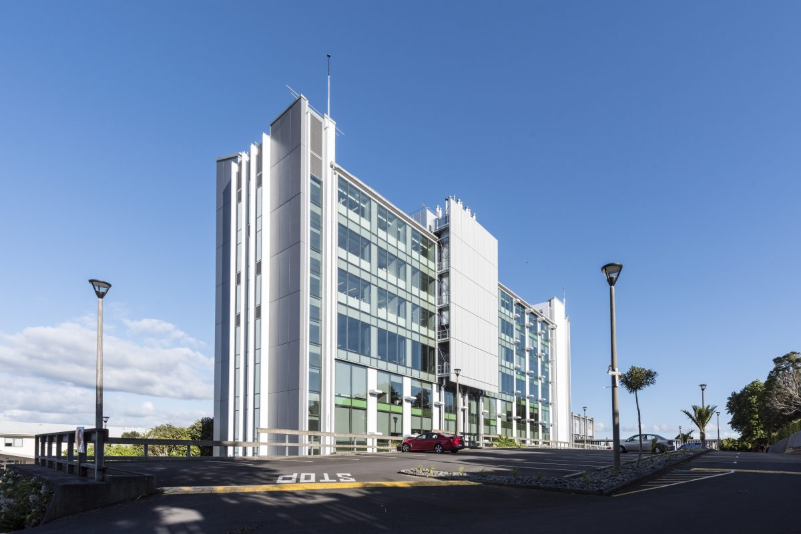
Company background
Plant & Food Research
One of seven Royal Institutes in New Zealand jointly funded by the government and investors.
The Institute is an advanced research institution which not only researches advanced technologies but also combines them with traditional agricultural methods to improve the competitiveness of global agronomy.
The Institute has 15 research institutes, employs more than 1,000 people in New Zealand

Slide 3
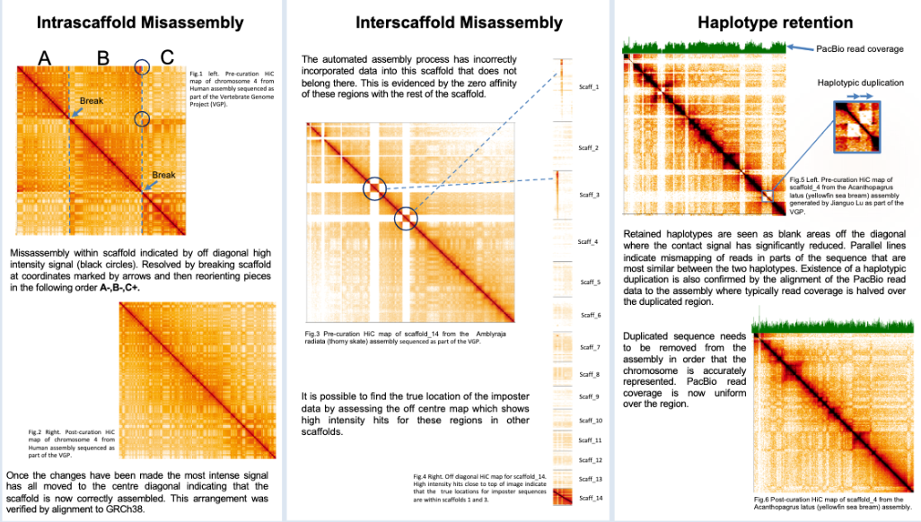
Project description
Chromosomes of almost all species to date have higher order organizational features.
HI-C can determine the average frequency of contacts between chromosomes and DNA segments within a genome
Genome assembly is putting nucleotide sequences into the correct order and orientation.

Slide 4
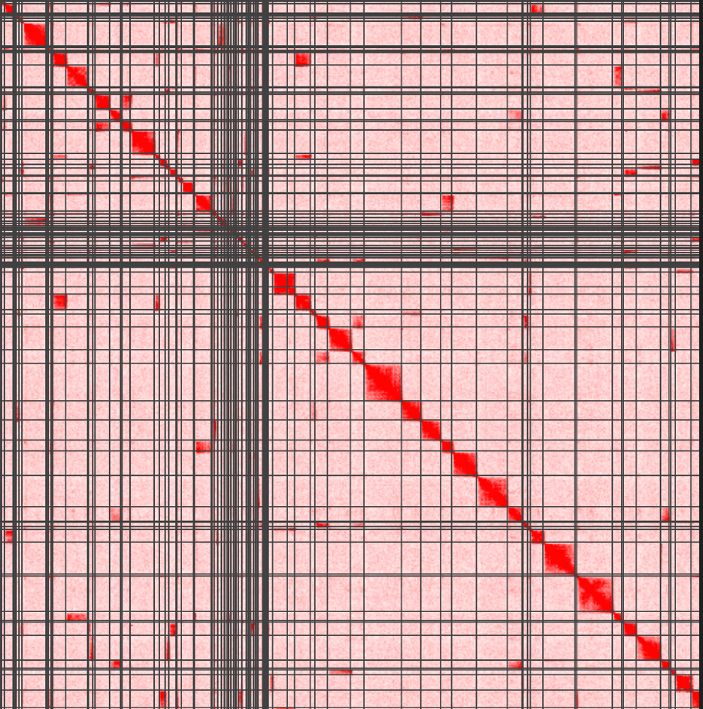
Each row and column represents a contig, for example, in the diagram below, each row from top to bottom represents contig 1 to contig 100, then each column from right to left also represents contig 1 to contig 100.
Extract contigs based on interaction signals
Contig102
Contig457
Cluster x (pseudochr x)
……
Cluster 2 (pseudochr 2)
Cluster 1 (pseudochr 1)
Contig93
Select the best heatmap
Re-order and re-orientate separately
Run the whole process more than once if necessary
Combine and regenerate Hi-C map on all clusters to check.
Note that we don't need to make any changes in the image, we are changing the information in the file that generated the image(.hic file)..

Slide 5
Goal
Understanding data generation process, intermediate & result files and HiC heatmaps
Generating HiC heatmaps with different resolutions
Identification of chromosomal territories based on the image/bin matrix
Strategy to detect contig clusters
Optimization
Evaluation
Documentation

Slide 6
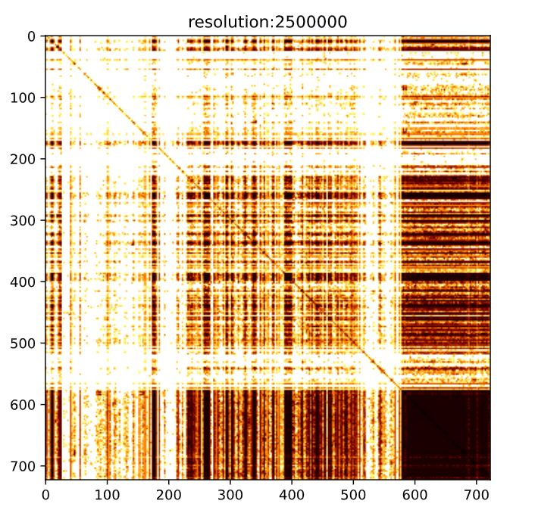
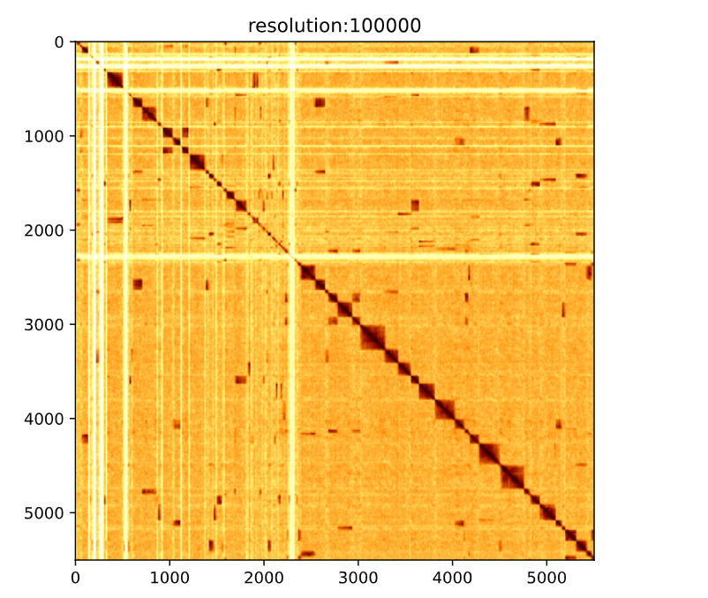
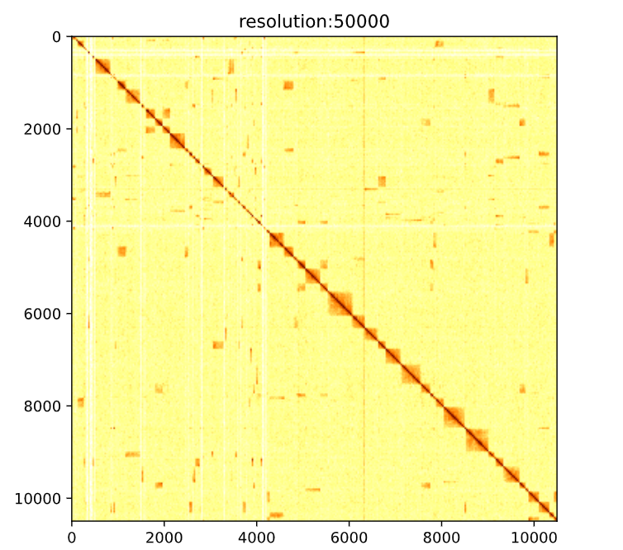
Project Result Heatmaps generation
Tool: Chromosight
Resolution is represented by bin size
I.e. resolution 1k – bin 1k dots into one pixel

Slide 7
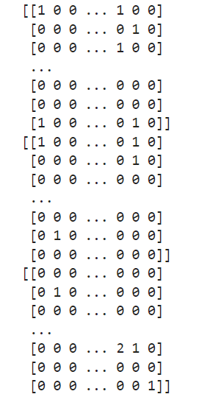

Cluster contigs to chromosomes – peak detection
5,503
Image/matrix split by rows
Examples:
106
39
91

Slide 8
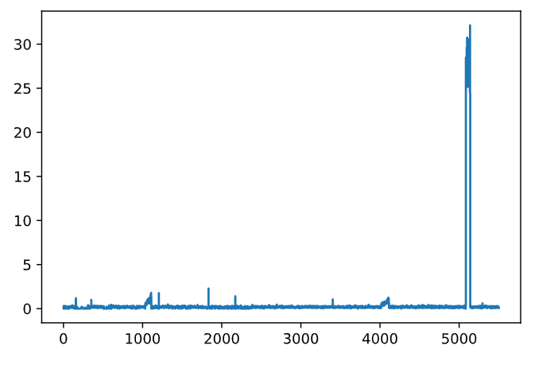
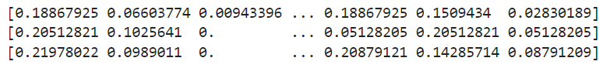
Peak detection
Based on the column of the row matrix
Only detect contigs longer than 500kb (93 contigs, 566 contigs per row)
calculate mean for each column, will generate a sequence with column mean.

Slide 9
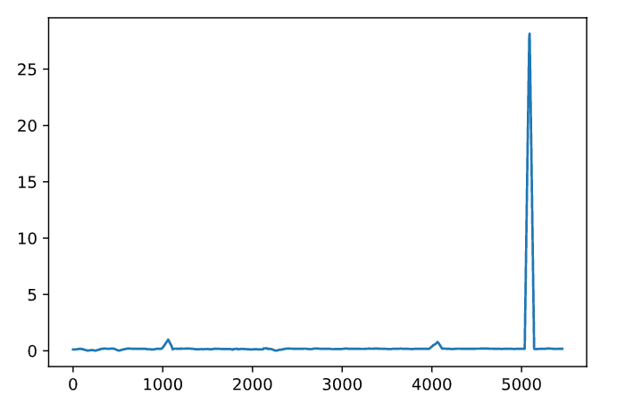
Smooth sequence use suit window length.

Slide 10
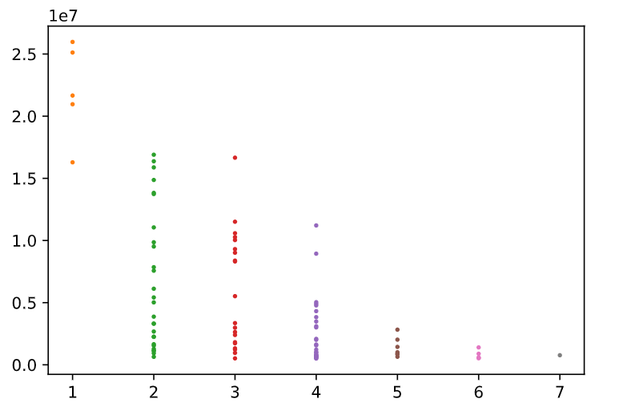
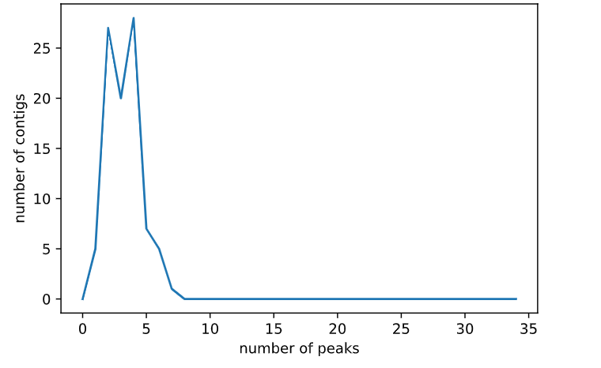
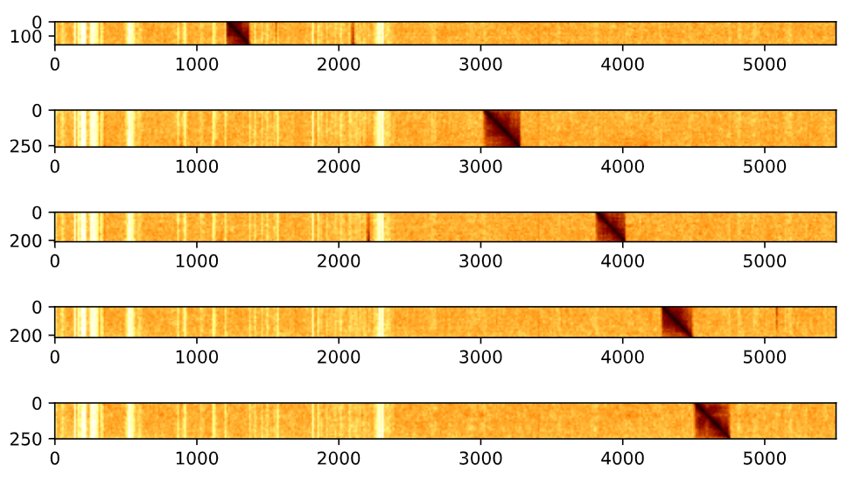
Peak detection result
Most of contigs were detected with peaks between 2 and 4
Longer contigs correspond to less number of detected peaks
TH: median_height*4
Contig length
Number of peaks

Slide 11
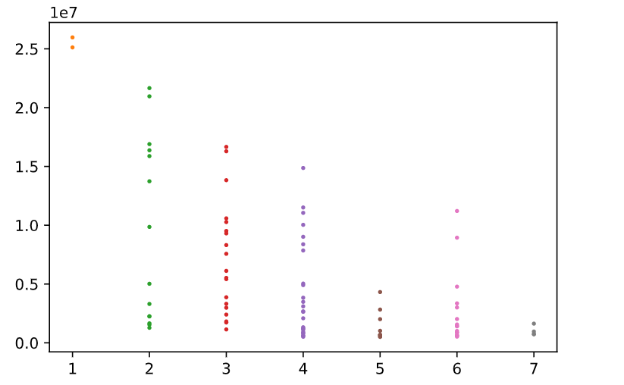
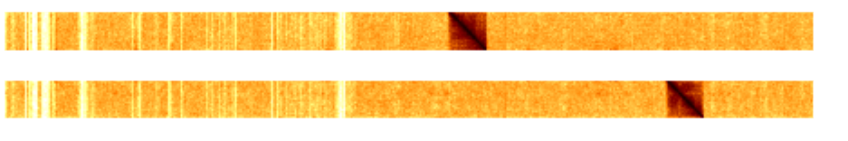
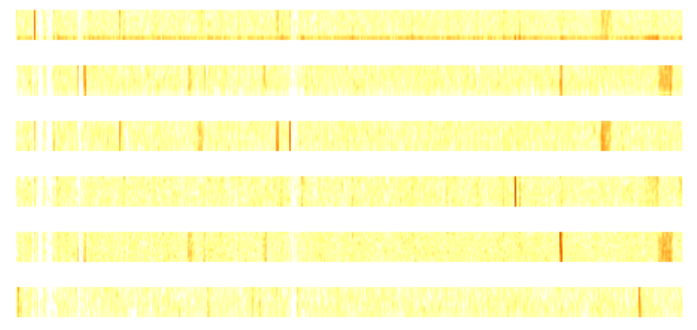
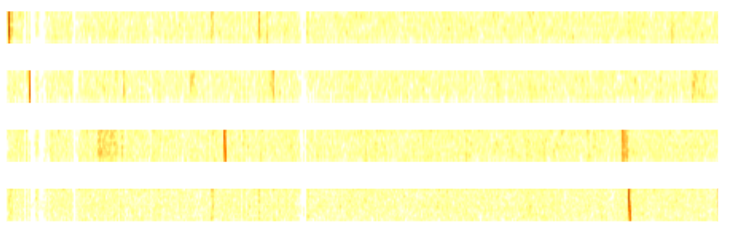
Peak detection threshold adjustment
TH: median_height*4
TH: median_height*3
Resize to be visible

Slide 12
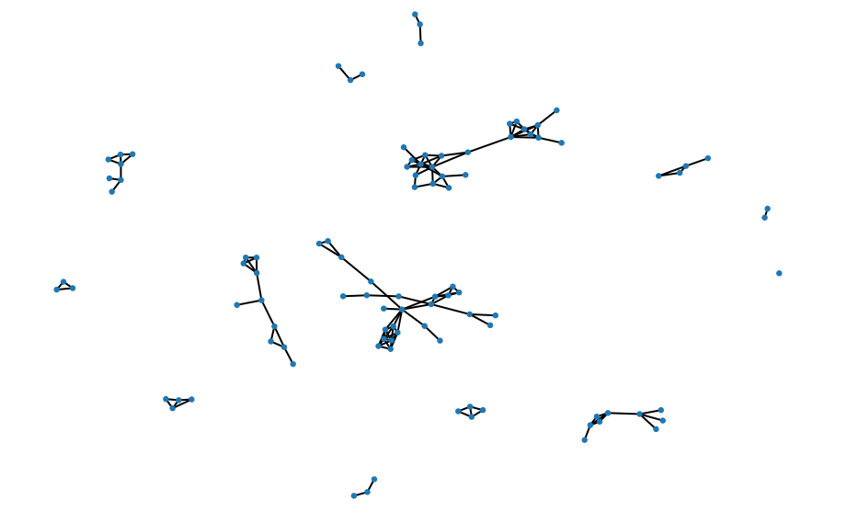
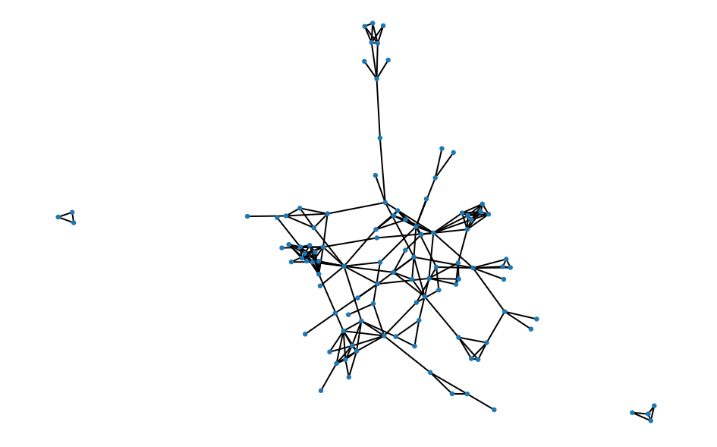
Network graph
Reduced TH induces more false positive connections
TH: median_height*4
TH: median_height*3

Slide 13
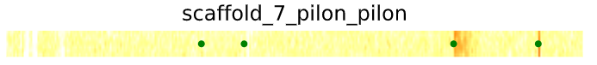
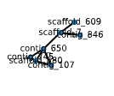
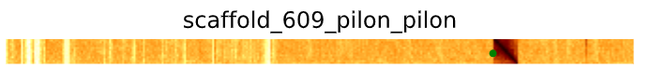



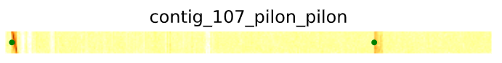
What was wrong for this cluster?

Slide 14
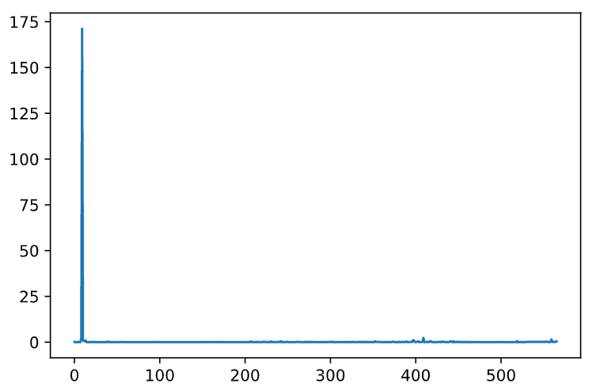
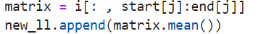
Peak detection
Based on the contig
Only detect contigs longer than 500kb (93 contigs, 566 contigs per row)
calculate mean for each contig, will generate a sequence with column mean.

Slide 15
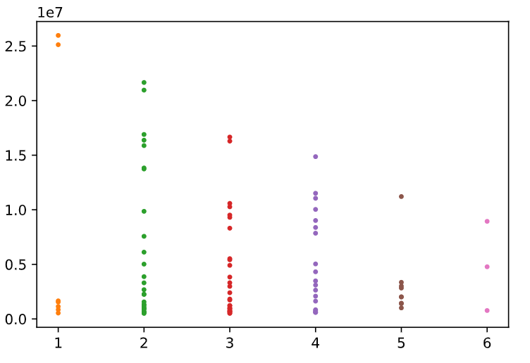
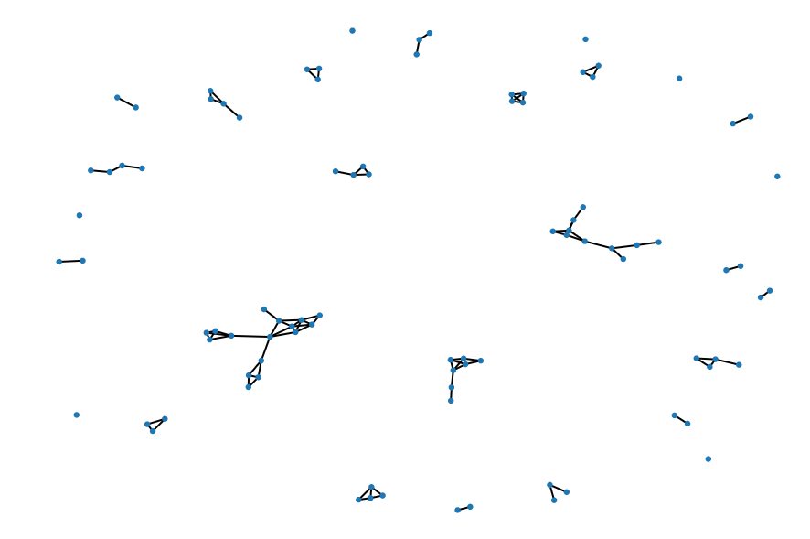
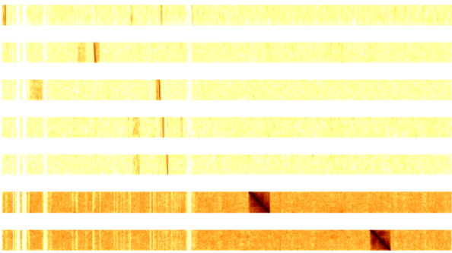
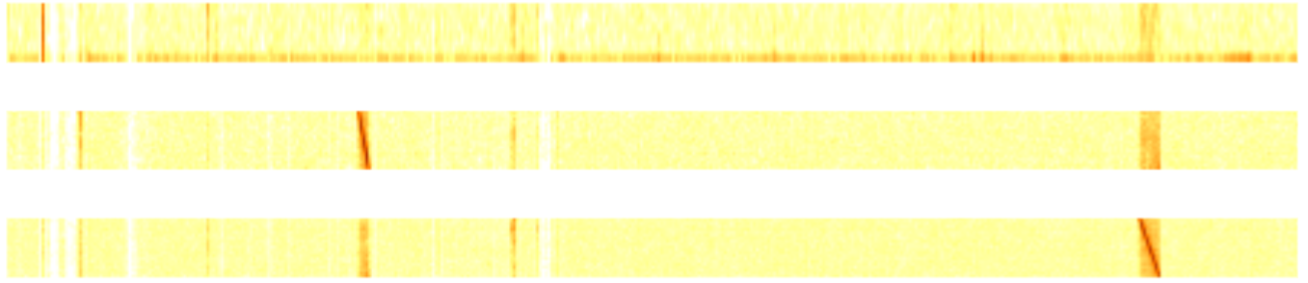
Peak detection, then do optimize
Optimize: Only put contigs that can detect each other as a cluster
TH: mean_height*3

Slide 16
Lesson learnt
Application of theory and knowledge to practice
basic understanding of python from my undergraduate studies provided me with a good foundation.
habit of learning how to write and some standard packages on various forums, youtube and Google
lot of meetings and presentations as I had gained enough experience to be able to do these processes in a structured way.
Gave me an understanding of images and how the various algorithms for image processing work.
innovative ideas when researching
networking skills

Slide 17
Professional attributes developed
Thank you!
lot of the knowledge or experience I learned in the course, as well as habits
developed my programming skills and integrated what I have learned.
developed a certain level of responsibility to think through the difficulties of the project on my own, and it also helped me to develop confidence

